Slide 1
Technical Expert Review of Belgium’s first BTR
Draft areas of improvement
Belgium TERT
April 2025

Slide 2
BTR General
Reporting requirements | Areas of Improvement
Paragraph 3(b), 3(d) and 62 of the MPGs Facilitating improving reporting and transparency overtime Promoting transparency, accuracy, completeness, consistency and comparability Information on procedurals arrangements for ... archiving of information ... | Possible encouragement The TERT encourages Belgium that, when providing references for additional information related to information included in its BTR, to ensure this information is easily accessible and consistent with the information included in the BTR.

Slide 3

NIR: General

Slide 4
NIR: General
Reporting requirements | Areas of Improvement
Paragraph 35 of the MPGs QA/QC | Possible recommendation The TERT recommends that Belgium implements and if necessary, enforces its QA/QC procedures in order to improve the overall quality and transparency of the reporting.

Slide 5


NIR: General

Slide 6
NIR: General
Reporting requirements | Areas of Improvement
Paragraph 52 of the MPGs Indirect N2O emissions | Possible encouragement The TERT encourages Belgium to improve the reporting of indirect emissions in the NID, clearly indicating which gases and emissions are included or not included in the inventory and weather these emissions are included or not in national totals.

Slide 7
NIR: General
Reporting requirements | Areas of Improvement
Paragraph 29 and 44 of the MPGs Reporting of uncertainties | Possible recommendation The TERT recommends that Belgium quantitatively estimates and qualitatively discusses the uncertainty of the emission and removal estimates for all source and sink categories for the starting year (1990) of the inventory time series.
Daniel Bretscher
2.11.2009

Slide 8
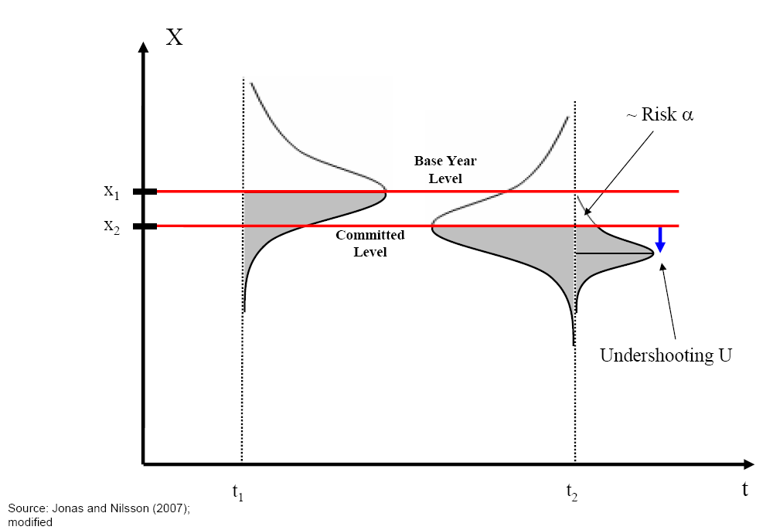
Compliance and confidence: Uncertainties.

Slide 9
NIR: Energy sector
Reporting requirements | Areas of Improvement
Paragraph 23 of the MPGs 1.A.3.e Other transportation – liquid and gaseous fuels – CO2 | Possible recommendation The TERT recommends that Belgium include in the NID under key category 1.A.3.e clear information on the country-specific EF sources for sub-category 1.A.3.e.i and provide a thorough and clear explanation why the methodological choice for CO2 emissions from liquid fuels under the sub-category 1.A.3.e.ii was not in line with the corresponding decision tree of the IPCC guidelines and document the planned improvements to develop country-specific CO2 EFs.
Paragraph 23 of the MPGs 1.A.4 Other sectors – solid and liquid fuels – CO2 | Possible recommendation The TERT recommends that Belgium include in the NID a thorough and clear explanation why the methodological choice for CO2 emissions from liquid fuels and solid fuels for all regions for the key category 1.A.4 was not in line with the corresponding decision tree of the IPCC guidelines and document the planned improvements to develop country-specific CO2 EFs.

Slide 10
NIR: Energy sector – Minor issues
Reporting requirements | Areas of Improvement
Paragraph 35 of the MPGs 1.B.1.b Fuel transformation – CO2, CH4 | The TERT encourages Belgium to correct the information provided in the NID (section 3.3.1.2.2, p.134) on the notation key reported for category 1.B.1.b to ‘NO’. (Annex: Energy #1)
Paragraph 35 of the MPGs 1.B.2.c Venting and flaring – CO2 | The TERT acknowledges that in certain cases the associated activity data is unavailable when direct measurements are used. However, since CO₂ emissions are reported as ‘IE’, the TERT encourages that Belgium also report the corresponding activity data as ‘IE’ under category 1.B.2.c.i.1 in CRT Table1.B.2. (Annex: Energy #2)
Paragraph 35 of the MPGs 1.B.2.a Oil – CO2, CH4 | The TERT encourages that Belgium report oil product distribution using the notation key ‘NA’ in CRT Table 1.B.2, as these activities occur domestically, but result only in non-methane volatile organic compounds (NMVOC) emissions. (Annex: Energy #3)

Slide 11
NIR: Energy sector – Minor issues
Reporting requirements | Areas of Improvement
Paragraph 35 of the MPGs 1.B.2.c Venting and flaring – CO2 | The TERT acknowledges that in certain cases the associated activity data is unavailable when direct measurements are used. To improve transparency, the TERT encourages that Belgium report values in the activity data field, e.g. m3 oil refined, even if this data is not used in the actual emission calculations. Additionally, the TERT encourages Belgium to use the documentation box in CRT Table 1.B.2 and provide an explanation in the NID to clarify the approach taken and the rationale behind it. (Annex: Energy #4)

Slide 12
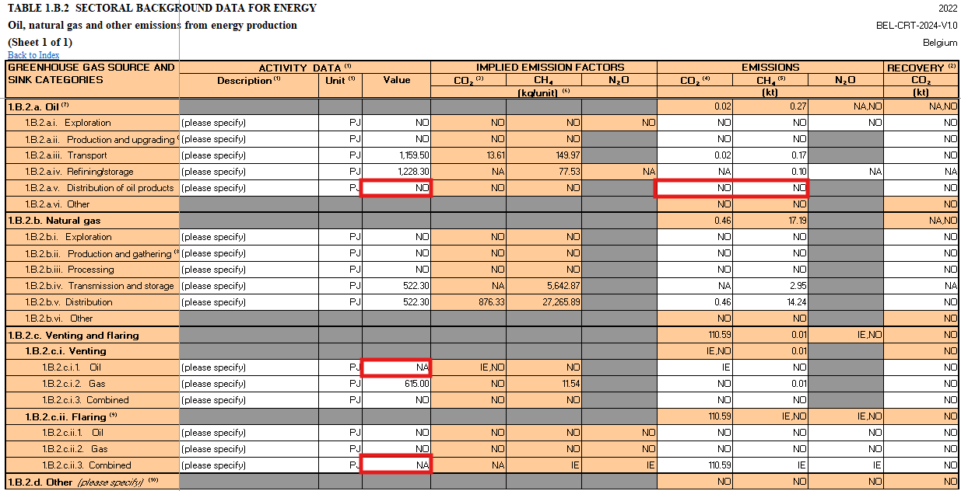
NIR: Energy sector – Minor issues

Slide 13
NIR: IPPU sector
Reporting requirements | Areas of Improvement
Paragraph 21, 23 of the MPGs IPPU-Ammonia Production-CO2 | Possible recommendation The TERT recommends that the Party correct misreported information and report additional explanation on using plant-specific emission factor for key category 2.B.1 Ammonia production in the Flemish region accordingly in the next submission. Belgium reported in its NID (section 4.3.2.1, p156) that it has been using default IPCC 2006 emission factors for CO₂ under key category 2.B.1 Ammonia production in the Flemish region. During the review, the Party explained that the plants have performed analyse on the C content of the natural gas and the plant-specific emission factor already been used for this category. But the Party did not include this information in NID.

Slide 14
NIR: Agriculture sector
Reporting requirements | Areas of Improvement
Paragraph 39 of the MPGs Agriculture – CO₂, CH₄, N₂O | Possible encouragement The TERT encourages Belgium to provide more information on the emission profiles of the three regions e.g. by providing figure 5.1 in the NID separately for the three regions. The information should specifically illustrate how the overall emission profiles in Belgium can be explained by the weighing of the emissions of the three regions.

Slide 15
NIR: Agriculture sector

Slide 16
NIR: Agriculture sector
Reporting requirements | Areas of Improvement
Paragraph 39 of the MPGs Agriculture – CO₂, CH₄, N₂O | Possible encouragement The TERT encourages Belgium to provide more information on the agricultural structures and managements in the three regions in the overview section of chapter 5 “Agriculture” in the NID including information on the respective temporal developments across the inventory time-period.

Slide 17
NIR: Agriculture sector
Reporting requirements | Areas of Improvement
Paragraph 57 of the MPGs Agriculture – CH₄, N₂O | Possible recommendation The TERT recommends that Belgium applies an approach to harmonize time series of population data of mature dairy cattle, swine and sheep in accordance with the 2006 IPCC Guidelines vol. 1, chap. 5.

Slide 18
NIR: Agriculture sector

Slide 19
NIR: Agriculture sector
Reporting requirements | Areas of Improvement
Paragraph 39 of the MPGs Agriculture – N₂O | Possible recommendation The TERT recommends that Belgium correct the reporting of AD in CRT 3.D in t rather than in kg to ensure comparable N₂O IEF reported in the table.

Slide 20
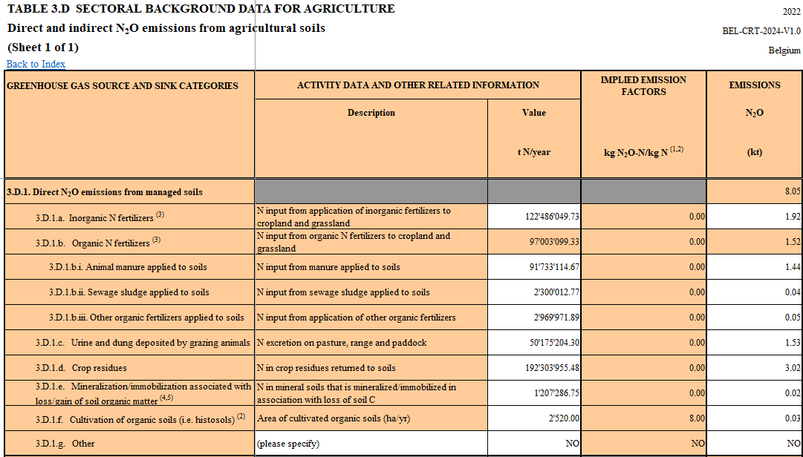

NIR: Agriculture sector
1 t

Slide 21
NIR: Agriculture sector
Reporting requirements | Areas of Improvement
Paragraph 22 of the MPGs Agriculture – N₂O | Possible encouragement The TERT encourages Belgium to improve the reporting of N₂O emissions from agriculture by providing a clear and consistent description of the amounts of nitrogen in the manure balance, including the amounts of nitrogen in manure exported and processed and the amounts of nitrogen coming from bedding material.

Slide 22
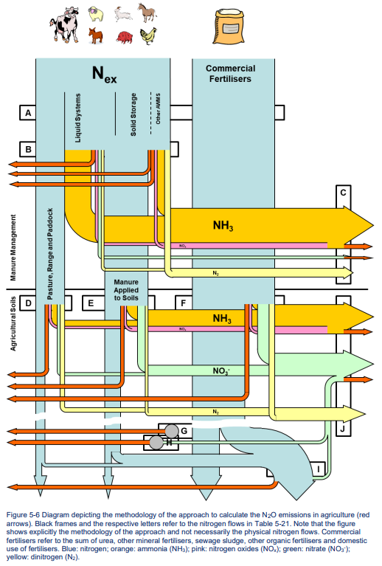
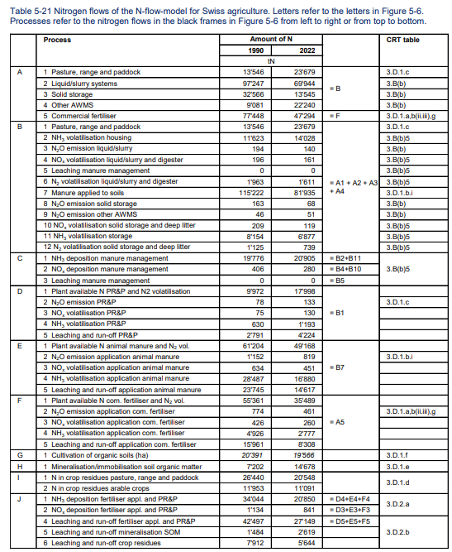
NIR: Agriculture sector

Slide 23

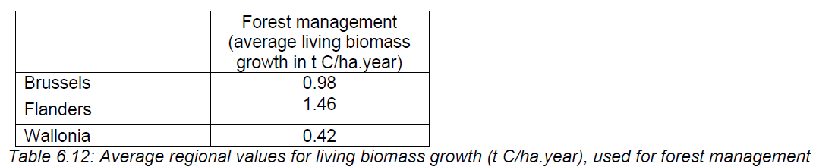
NIR: LULUCF sector
Reporting requirements | Areas of Improvement
Paragraph 39 of the MPGs LULUCF – Forestland remaining forestland – Change in carbon stock in living biomass | Possible recommendation The TERT recommends the Party to provide more detailed explanation of the proportion of different forest types for each region as well as the average carbon stocks in living biomass by regions directly in the report to enhance the understanding of information used in the estimations.

Slide 24




NIR: LULUCF sector
Reporting requirements | Areas of Improvement
Paragraph 21 of the MPGs LULUCF – Cropland – post-deforestation biomass growth rate | Possible recommendation The TERT recommends the Party to collect national values for key categories such as post-deforestation biomass growth rate on croplands to provide more accurate values in future submissions.
Paragraph 40 of the MPGs LULUCF – Cropland – areas of land converted to cropland | Possible recommendation The TERT recommends the Party to correct the information on areas of land converted to Cropland in the CRT tables for future submissions to ensure full consistency of the information between the NID and CRT.
Carbon stock
0?
Land in transition (20years)
Land Use

Slide 25
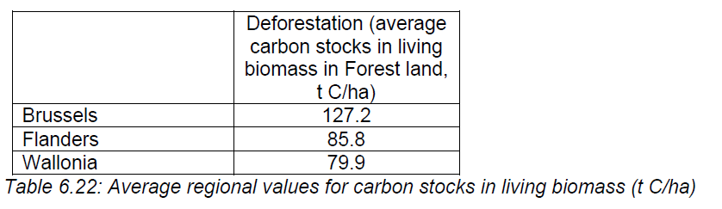
NIR: LULUCF sector
Reporting requirements | Areas of Improvement
Paragraph 26 of the MPGs LULUCF – Carbon stock changes in living biomass on Forestland converted to Cropland/Grassland/Settlement | Possible recommendation The TERT recommends the Party to include an explanation in the NID underlying the discrepancy with the CRT tables as well as the table with the correct values for the areas of land converted, the carbon stock in living biomass and final emissions/removals for the timeseries.
CRTs 4.B,4.C,4.D. 4.E
NID table 6.22

Slide 26
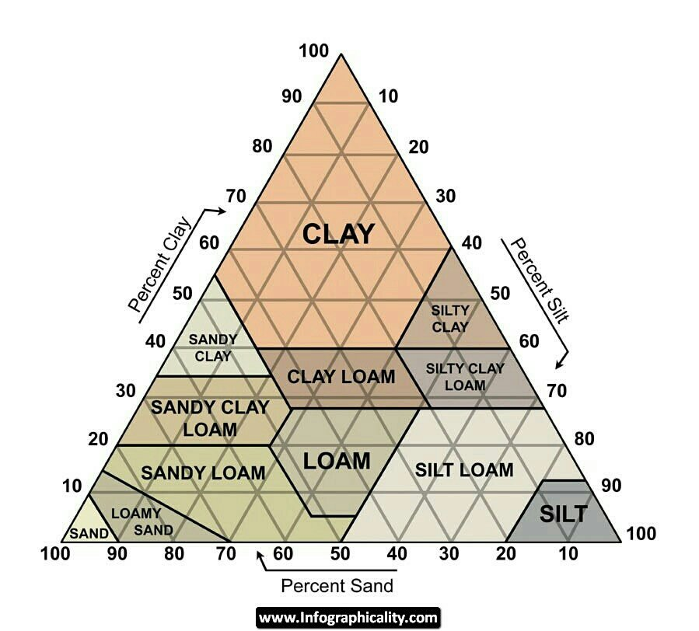
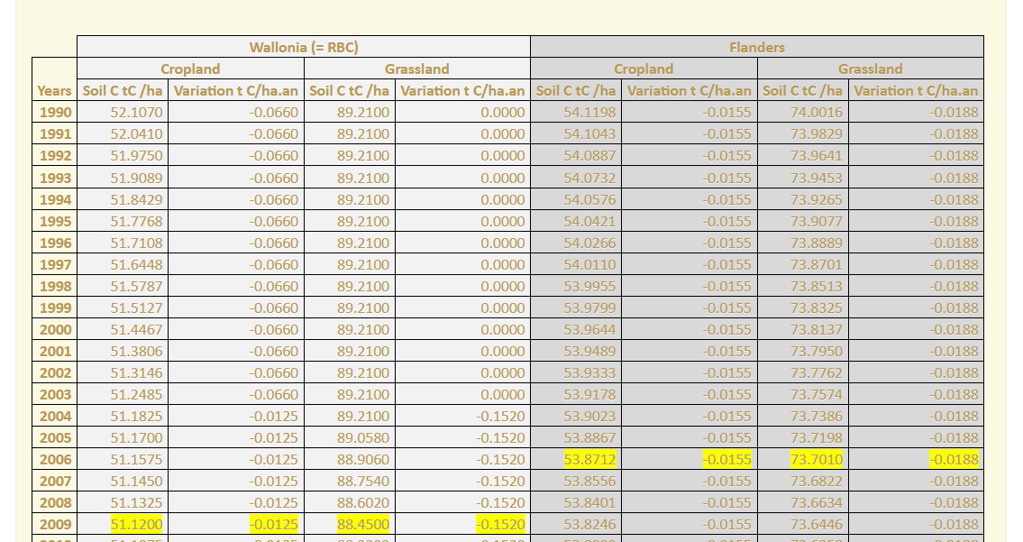
NIR: LULUCF sector
Reporting requirements | Areas of Improvement
Paragraph 39 of the MPGs LULUCF – Grassland/Cropland – Soils organic Carbon in Mineral Soils in land use change | Possible recommendation The TERT recommends the Party to include further details on the estimations of carbon stock change in mineral soils in future submissions to allow for complete transparency of how the IPCC guidelines are applied and what are the final SOC values used for the different land uses to allow for complete reproductivity of the estimations.
Paragraph 40 of the MPGs LULUCF – Grassland– Area of organic soils | Possible recommendation The TERT recommends the Party to check the activity data on area of organic soils for grasslands and make the necessary corrections. Additionally, the TERT recommends that the Party provide an explanation for the uncertainty of the grid sampling approach of land representation in future submissions with a clear indication of possible impact this could have with incorrect interpretation for the different areas of land use and land use change.
1990-2008
2008-2022
400ha
200ha

Slide 27
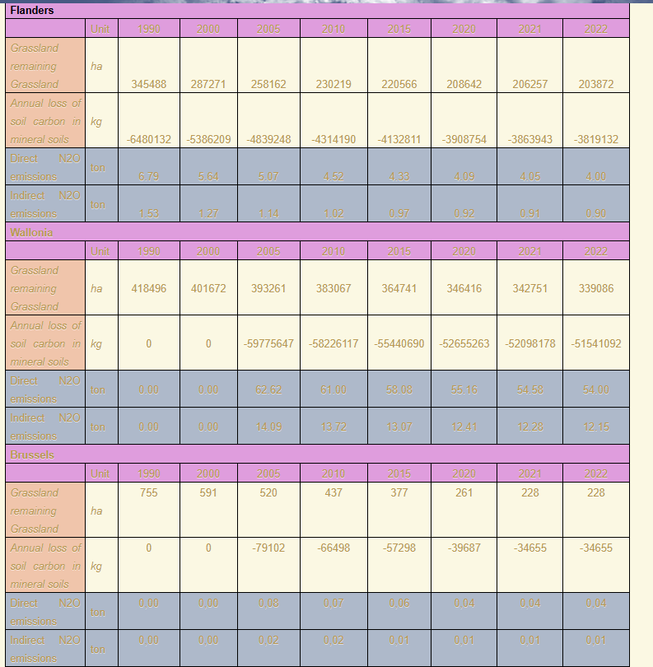

NIR: LULUCF sector
Reporting requirements | Areas of Improvement
Paragraph 40 of the MPGs LULUCF – Grasslands – direct and indirect N2O emissions | Possible recommendation The TERT recommends the Party to include in tables 6.3 and 6.4 the additional area on annual loss of soil carbon in mineral soils and direct/indirect N2O emissions from grassland remaining grassland in the next report to ensure full consistency of the information between the NID and CRT.

Slide 28

NIR: Waste sector
Reporting requirements | Areas of Improvement
Paragraph 30, 45, 47 of the MPGs Waste – 5.C.2 Open burning of waste – CO₂ non-bio, CH₄, N₂O | Possible recommendation The TERT recommends the Party to improve transparency and include an explanation with the references in their next NID that open burning is prohibited by law in all regions of Belgium.

Slide 29

NIR: Waste sector – Minor issue
Reporting requirements | Areas of Improvement
Paragraph 29 of the MPGs Waste – 5.C.1 Waste incineration – N₂O | The TERT recommends the Party to improve their QA/QC and add the correct reference for uncertainty on the emission factor for calculating N₂O in 5C1 for the next submission.

Slide 30
Information necessary to track progress made in implementing and achieving its NDC: Policies and Measures
Reporting requirements | Areas of Improvement
Paragraphs 60 and 63of the MPGs Information on how the party's national circumstances affect GHG emissions and removals over time. | Possible recommendation The TERT recommends that the Party include in its next reporting information on how its national circumstances and sectoral changes influence GHG emissions and removals over time. This can be done by either providing clear references to previously reported information or by including a dedicated section in the BTR.
Paragraphs 83 and 84 of the MPGs information for each action, policy and measure reported: (a) Costs; (b) Non-GHG mitigation benefits; (c) How the mitigation actions interact with each other | Possible encouragement The TERT encourages the Party to include in future BTRs to provide details on costs, non-GHG benefits, and the interactions between the mitigation actions, as this will enhance the transparency and comprehensiveness of the reporting.

Slide 31
Information necessary to track progress made in implementing and achieving its NDC: Policies and Measures
Reporting requirements | Areas of Improvement
Paragraph 85 of the MPGs estimates of expected and achieved GHG emission reductions for its actions, policies and measures in the tabular format referred to in paragraph 82 of the MPGs | Possible recommendation The TERT recommends that the Party, to the extent possible, provide estimates of expected and achieved GHG emission reductions for its actions, in accordance with paragraph 85 of the MPGs.
Paragraph 86 of the MPGs methodologies and assumptions used to estimate the GHG emission reductions or removals due to each action, policy and measure, to the extent available. | Possible recommendation The TERT commends the Party for its efforts in ensuring the harmonization of methodologies across different sectors and actions. However, to enhance the clarity of Belgium's reporting, the TERT recommends that, to the extent possible, descriptions of the methodologies and assumptions used to estimate GHG emission reductions or removals for each individual PAM be provided.
Paragraph 89 of the MPGs information about how its actions, policies, and measures are modifying longer-term trends in GHG emissions and removals. | …Possible encouragement The TERT noted that, while Party did not explicitly state in its BTR how it believes its PaMs are modifying longer-term trends in GHG emissions, many of the PaMs reported are expected to have lasting effects on such trends, as suggested in the projections for 2050. The TERT encourages Party to explain specifically, to the extent possible, how its actions, policies and measures are modifying longer-term trends in GHG emissions and removals.

Slide 32
Information necessary to track progress made in implementing and achieving its NDC: Policies and Measures
Reporting requirements | Areas of Improvement
Paragraph 89 of the MPGs information about how its actions, policies, and measures are modifying longer-term trends in GHG emissions and removals. | …Possible encouragement The TERT noted that, while Party did not explicitly state in its BTR how it believes its PaMs are modifying longer-term trends in GHG emissions, many of the PaMs reported are expected to have lasting effects on such trends, as suggested in the projections for 2050. The TERT encourages Party to explain specifically, to the extent possible, how its actions, policies and measures are modifying longer-term trends in GHG emissions and removals.

Slide 33
Information necessary to track progress made in implementing and achieving its NDC: Projections
Reporting requirements | Areas of Improvement
Paragraph 96(c) of the MPGs Assumptions on policies and measures included in the ‘with measures’ projections and ‘with additional measures’ projections | Possible encouragement The TERT encourages the Party to include information on which policies and measures are included in the WM scenario and in the WAM scenario only.
Paragraph 96(d) of the MPGs Information should include sensitivity analysis for any of the projections, together with a brief explanation of the methodologies and parameters used | Possible encouragement The TERT encourages the Party to improve its quality control procedures to prevent processing errors, in its nest BTR submission.

Slide 34
Information necessary to track progress made in implementing and achieving its NDC: Projections
Reporting requirements | Areas of Improvement
Paragraph 96(d) of the MPGs Information should include sensitivity analysis for any of the projections, together with a brief explanation of the methodologies and parameters used | Possible encouragement The TERT encourages the Party to enhance the analysis providing a textual explanation of the results obtained, in the next BTR submission.
Paragraph 98 of the MPGs Each Party shall include projections on a sectoral basis and by gas, as well as for the national total, using a common metric consistent with that in its national inventory report. | Possible recommendation The TERT recommends that the Party report the information on projections at the level it has been developed (by region and subsector) to enhance transparency, in its next BTR submission.

Slide 35
FTC support
Reporting requirements | Areas of Improvement
Paragraph 119 (a) of the MPGs | Possible recommendation The TERT recommends that Belgium improves the transparency of its reporting on the institutional systems and processes at the national and sub-national level to identify, track and report the support provided through public interventions in its next BTR.
Paragraph 121 (d) (f) (g) of the MPGs Channel, instrument, institutions | Possible recommendation The TERT recommends that the party in its next report, improves the transparency of its reporting to align the use of institutions with the corresponding channel of financial flows and coherently list the institutions supporting specific programmes/activities.
Paragraph 121 (p) of the MPGs Support- needs and priorities of developing country Parties | Possible recommendation The TERT recommends that Belgium improves the transparency of its reporting in its next BTR by providing information on how the support provided and mobilized through public interventions effectively addresses the needs and priorities of developing country Parties for the implementation of the Paris Agreement.

Slide 36
FTC support
Reporting requirements | Areas of Improvement
Paragraph 122 of the MPGs TT | Possible recommendation The TERT recommends that the Party provides information on underlying assumptions, definitions and methodologies relating technology development and transfer in its next BTR.
Paragraph 126 (a) of the MPGs TT | Possible recommendation The TERT recommends that the Party in its next report, improves the transparency of its reporting by providing information on the strategies deployed to support technology development and transfer to the extent possible.
Paragraph 126 (f) of the MPGs TT | Possible recommendation The TERT recommends that the Party provides information on the knowledge generated related to technology development and transfer.

Slide 37
FTC support
Reporting requirements | Areas of Improvement
Paragraph 127 (d) of the MPGs TT (Minor) | Possible recommendation The TERT recommends that the Party, in its next BTR, improves the transparency of its reporting in the CTF table by classifying information on the type of support for technology development and transfer as mitigation, adaptation and cross cutting.
Paragraph 127 (h) of the MPGs TT (Minor) | Possible recommendation The TERT recommends that the party, to the extent possible, improves the transparency of its reporting in its next BTR by distinguishing between activities undertaken by the public and private sectors for technology development and transfer.
Paragraph 128 (a) of the MPGs CB | Possible recommendation The TERT recommends that the party, to the extent possible, provides information on the strategies employed to provide capacity-building support.

Slide 38
FTC support
Reporting requirements | Areas of Improvement
Paragraph 128 (c) of the MPGs CB | Possible recommendation The TERT recommends that the party in its next BTR reporting on the policies to promote capacity building.
Paragraph 128 (e) of the MPGs CB | Possible recommendation The TERT recommends that the party clearly reports in its next BTR on how support for capacity-building actions in developing country Parties that was provided promotes the sharing of lessons learned and best practices.
Paragraph 129 (d) of the MPGs CB (Minor) | Possible recommendation The TERT recommends that the party improves the transparency of its reporting by providing information on the type of support whether mitigation, adaptation or cross cutting.

Slide 39

Thank you!

Slide 40
Annex: Energy sector – Minor issues
# | Reporting requirements | Areas of Improvement
1 | Paragraph 35 of the MPGs 1.B.1.b Fuel transformation – CO2, CH4 | Belgium reported in its NID (section 3.3.1.2.2, p.134) that for category 1.B.1.b from 2015 no CO2 or CH4 emissions occur from coke production and that consequently the notation key ‘NA’ is reported. The TERT noted that in this case, the notation key ‘NO’ should be reported and that Belgium has correctly reported the notation key ‘NO’ in CRT Table1.B.1 from 2015 onwards. The TERT encourages Belgium to correct the information provided in the NID on the notation key reported for category 1.B.1.b to ‘NO’.
2 | Paragraph 35 of the MPGs 1.B.2.c Venting and flaring – CO2 | Belgium reported in its NID (section 3.2.6.2.2, p. 99) that emissions resulting from the production of hydrogen at refineries are included in the category 1.A.1.b instead of category 1.B.2.c.i.1 in the Belgian CRT-tables. Consequently, Belgium changed the notation key 'NO' in the category 1.B.2.c.i.1 venting/oil to 'IE' during the submission in 2021. The TERT confirms that Belgium reported the notation key ‘IE’ for CO2 emissions under category 1.B.2.c.i.1 in CRT Table1.B.2, but that for the associated activity data the notation key ‘NA’ is reported in CRT Table1.B.2. During the review, the Party explained that it has followed this approach as the associated activity data is unknown as the emissions come from direct measurements. The TERT acknowledges that in certain cases the associated activity data is unavailable when direct measurements are used. However, since CO₂ emissions are reported as ‘IE’, the TERT encourages that Belgium also report the corresponding activity data as ‘IE’ under category 1.B.2.c.i.1 in CRT Table1.B.2.

Slide 41
Annex: Energy sector – Minor issues
# | Reporting requirements | Areas of Improvement
3 | Paragraph 35 of the MPGs 1.B.2.a Oil – CO2, CH4 | Belgium reported in CRT Table1.B.2 the notation key ‘NO’ for CO2 and CH4 emissions under category 1.B.2.a.v. (distribution of oil products). The TERT noted that based on the information in the NID, transport and distribution of refined oil products will occur in Belgium. During the review, the Party confirmed that oil distribution activities do take place in the country and that a revision of the methodology for oil and natural gas systems is planned for next year. The TERT encourages that Belgium report oil product distribution using the notation key ‘NA’ in CRT Table 1.B.2, as these activities occur domestically, but result only in NMVOC emissions.
4 | Paragraph 35 of the MPGs 1.B.2.c Venting and flaring – CO2 | Belgium reported in its NID (section 3.2.6.2.2, p. 99) that the emissions from petroleum refineries are allocated under category 1.B.2.c.ii for the flaring emissions of CO2. The TERT noted that the associated activity data related to the flaring emissions of CO2 is reported as ‘NA’. During the review, the Party explained that it has followed this approach as the associated activity data is unknown as the emissions come from direct measurements. The TERT acknowledges that in certain cases the associated activity data is unavailable when direct measurements are used. To improve transparency, the TERT encourages that Belgium report values in the activity data field, e.g. m3 oil refined, even if this data is not used in the actual emission calculations.

Slide 42
Annex: Waste sector – Minor issue
Reporting requirements | Areas of Improvement
Paragraph 29 of the MPGs Waste – 5.C.1 Waste incineration – N₂O | The Party reported in its NID p. 297 that for calculating N₂O in 5C1 an uncertainty of 200% on the emission factor is applied. And the value is based on IPCC Good Practice Guidance. The TERT noticed that the data reported in NID does not match the data in IPCC Good Practice Guidelines document. During the review, the Party explained that uncertainty is taken from table 2.14 of the IPCC 2006 GL. The TERT recommends the Party to improve their inventory and add the correct reference in their NID for the next submission.

